Slide 1
EASYPARKING Online Car parking system
Presented By
Aniket N. Gonjare(233037)
Sham B. Girhe(233037)

Slide 2
Points to be discussed
Specification
Future Scope
Conclusion
Introduction
Objectives
UML Diagrams
Screenshots
S/W and H/W
Requirement

Slide 3
introduction
The "Car Parking System" has been developed to override the problems prevailing in the practicing manual system.
This software is supported to eliminate and in some cases reduce the hardships faced by this existing system. Moreover this system is designed for the particular need of the company to carry out operations in a smooth and effective manner.
The application is reduced as much as possible to avoid errors while entering the data. It also provides error message while entering invalid data.
No formal knowledge is needed for the user to use this system. Thus by this all it proves it is user-friendly. Car Parking System, as described above, can lead to error free, secure, reliable and fast management system.
It can assist the user to concentrate on their other activities rather to concentrate on the record keeping. Thus it will help organization in better utilization of resources.

Slide 4
Objectives
The main objective of the Project on Car Parking System is to manage the details of Car, Parking, Parking Space, Parking Slot, Parking Area. It manages all the information about Car, Parking Fees, Parking Area, Car.
The project is totally built at administrative end and thus only the administrator is guaranteed the access.
The purpose of the project is to build an application program to reduce the manual work for managing the Car, Parking, Parking Fees, Parking Space. It tracks all the details about the Parking Space, Parking Slot, Parking Area.

Slide 5
Technologies used
Front End – React JS
Back End – Java Spring Boot
Database – MySql

Slide 6
UML Diagrams

Slide 7
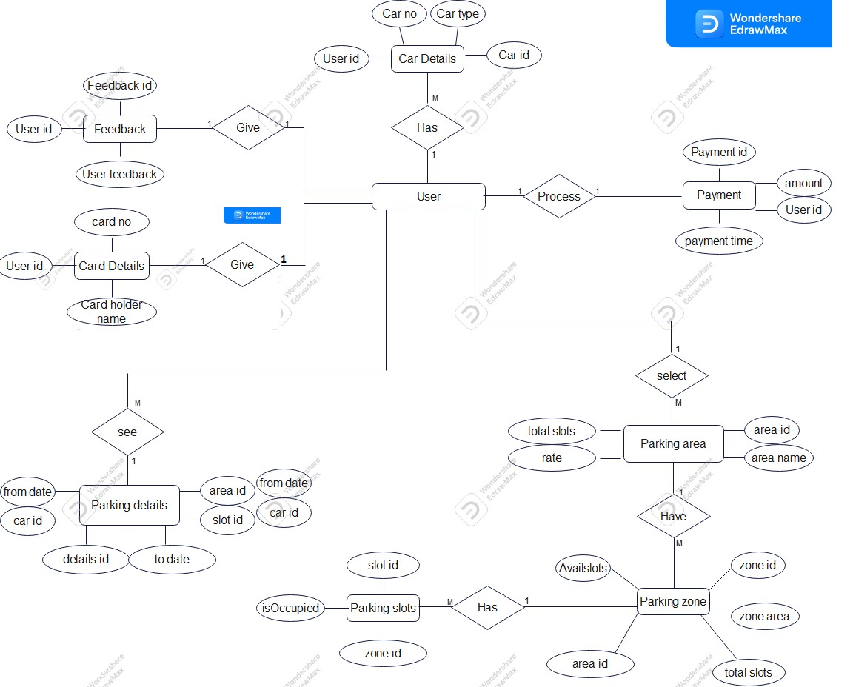
E-R Diagram

Slide 8
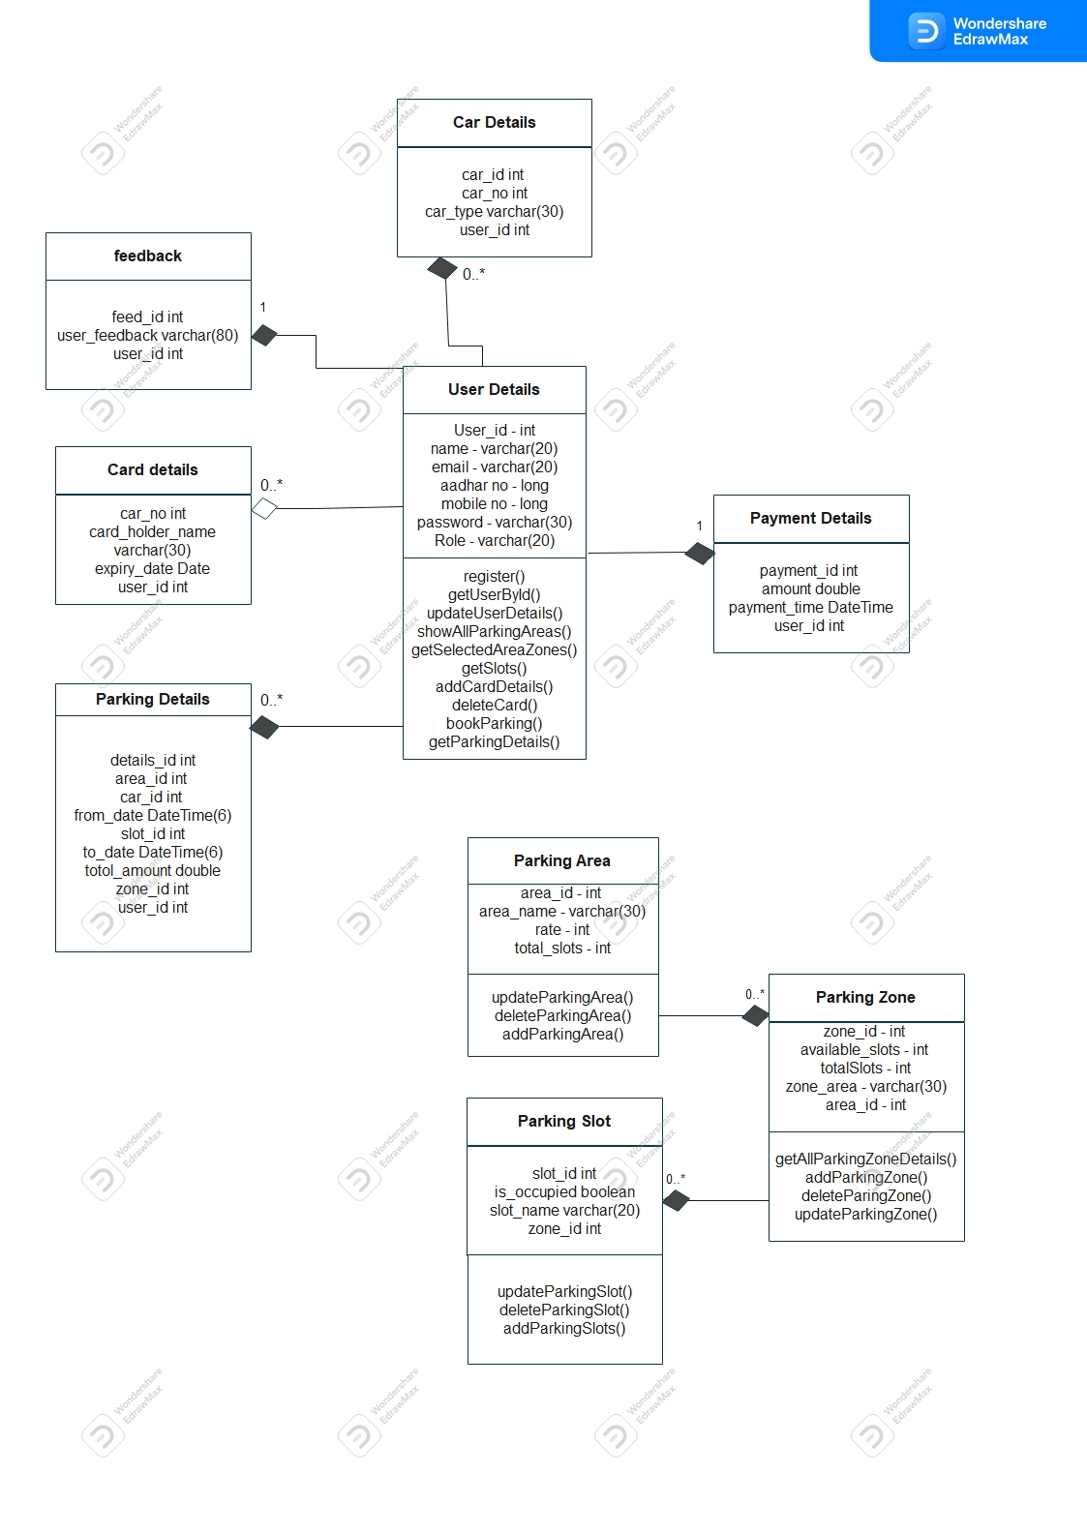
Class diagram

Slide 9
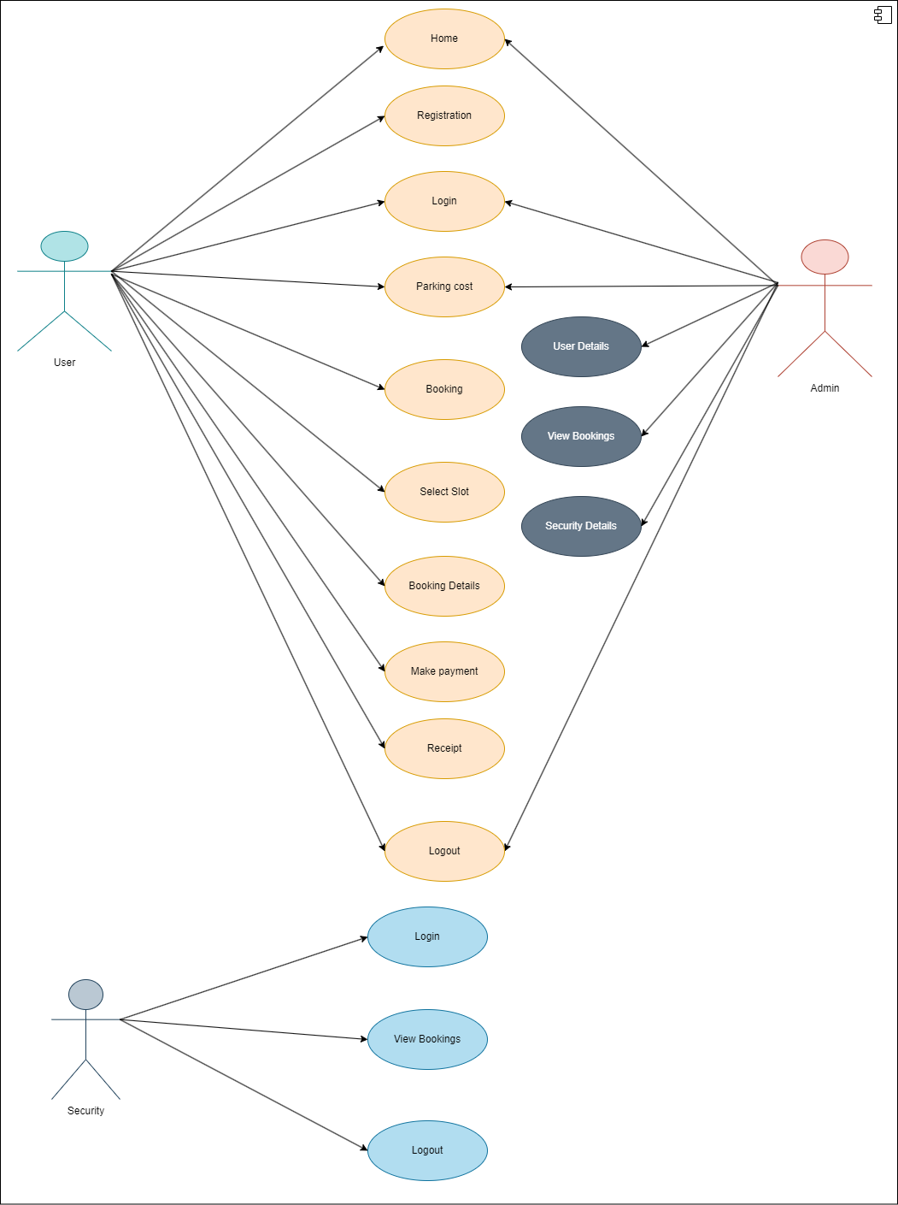
Admin use case diagram

Slide 10
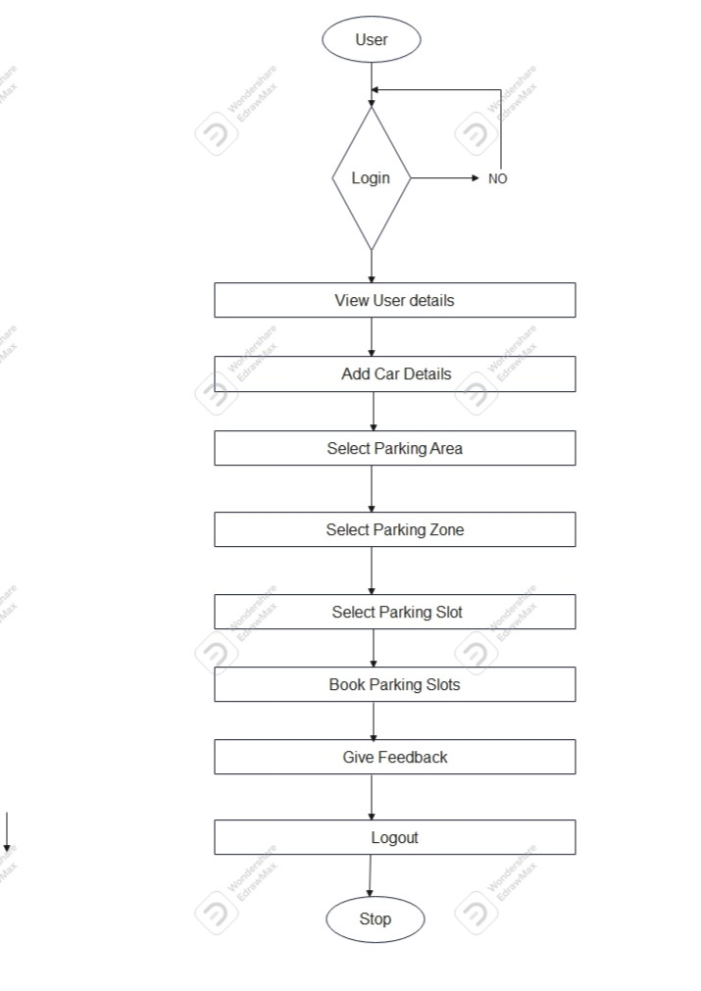
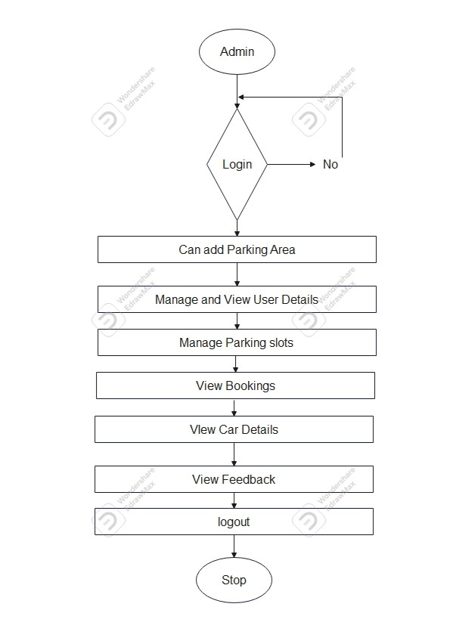
user and admin Activity diagram

Slide 11
screenshots

Slide 12
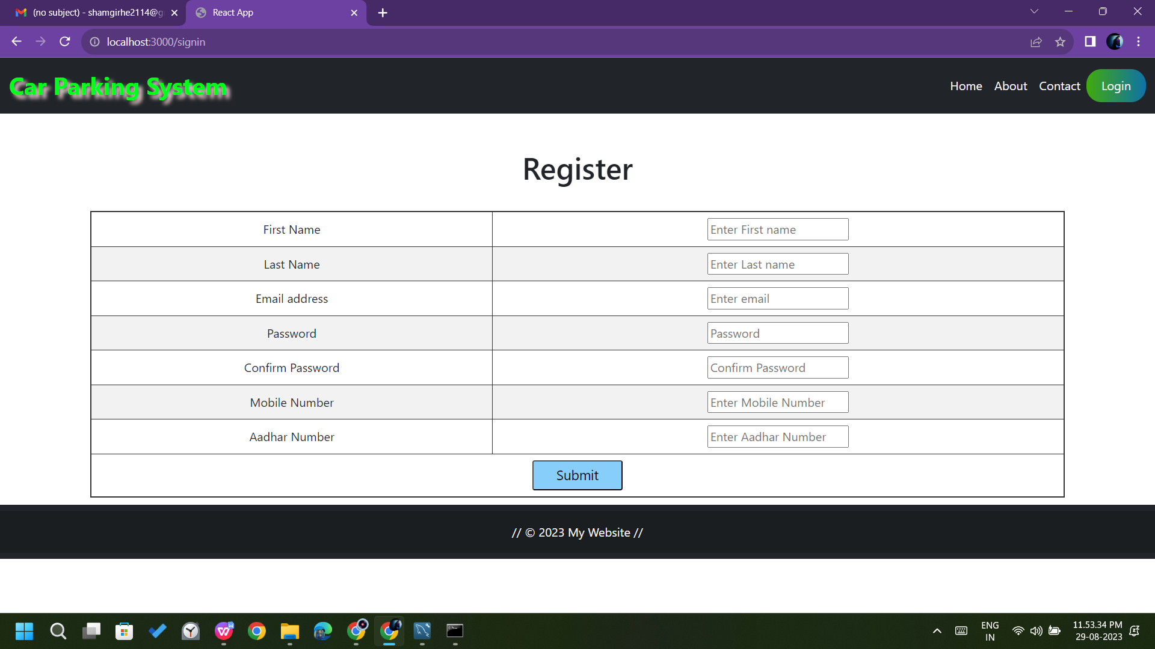
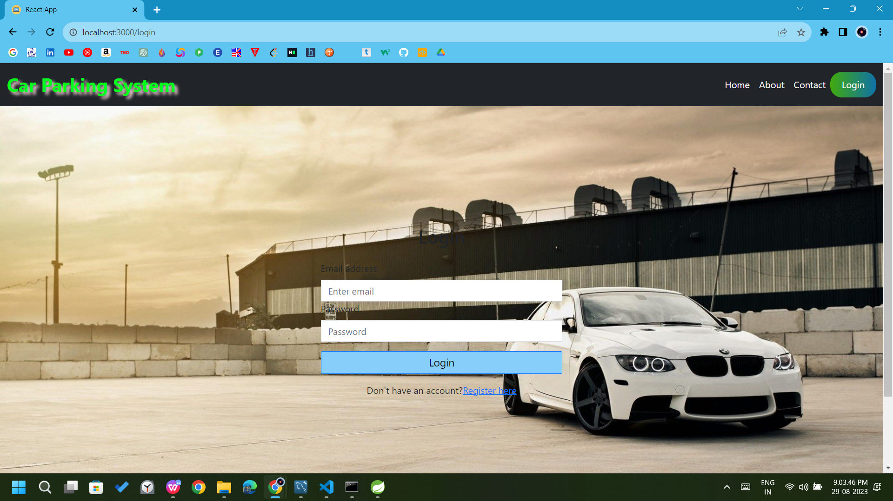
User registration and login page

Slide 13
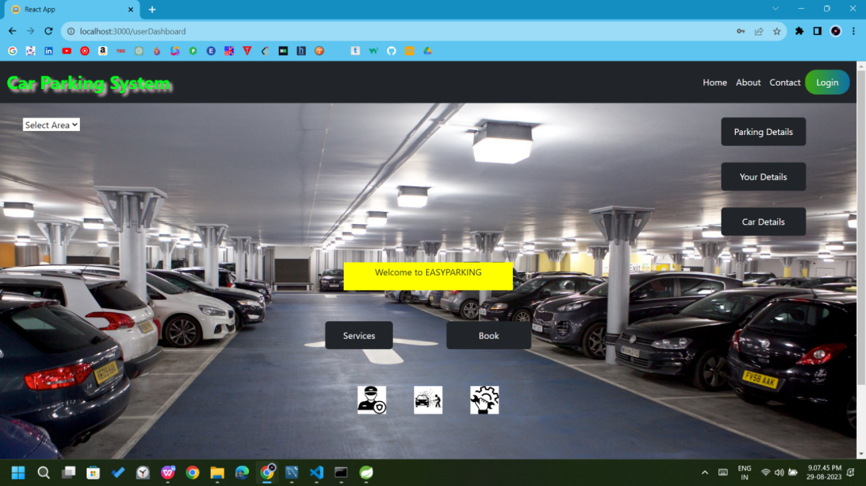
Dashboard after successful login

Slide 14
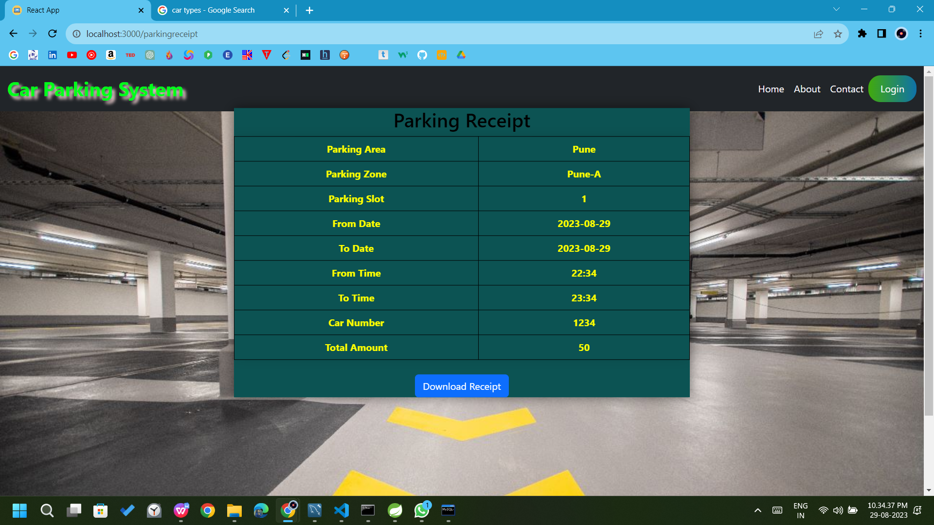
Parkingreceipt

Slide 15
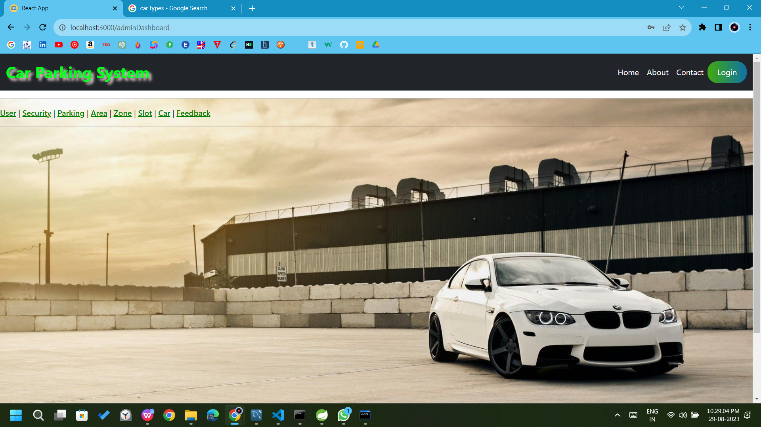
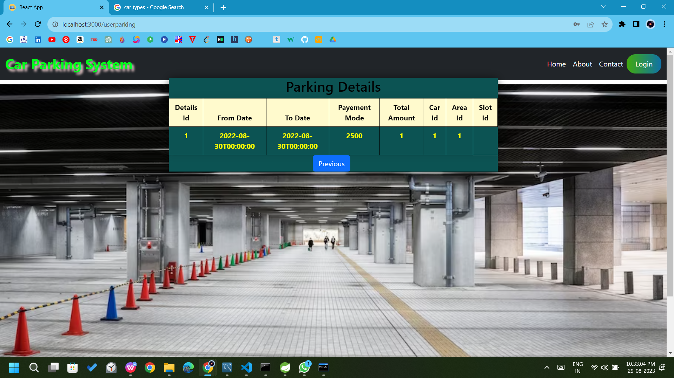
Userparking details and Admin Dashboard

Slide 16
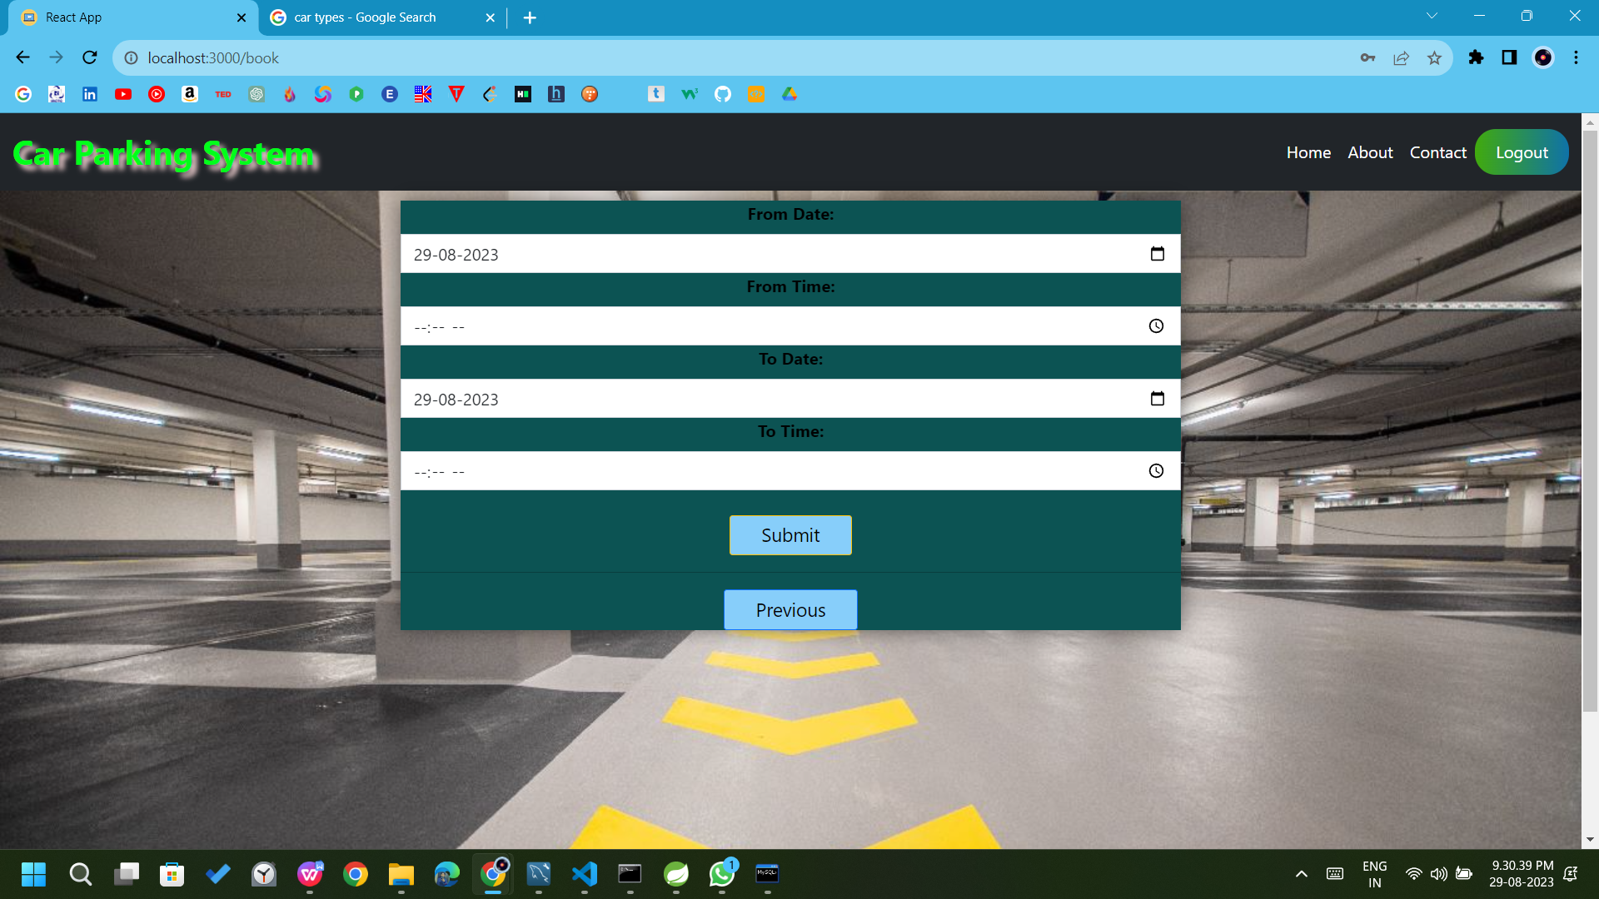
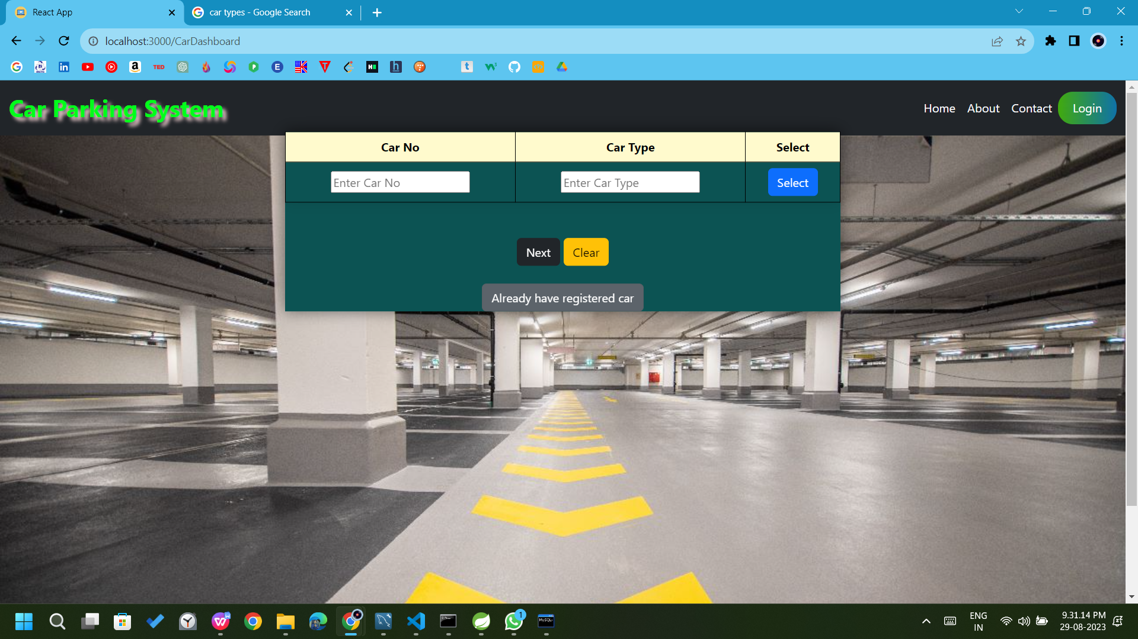
Selecting Time Details and Select Car details

Slide 17
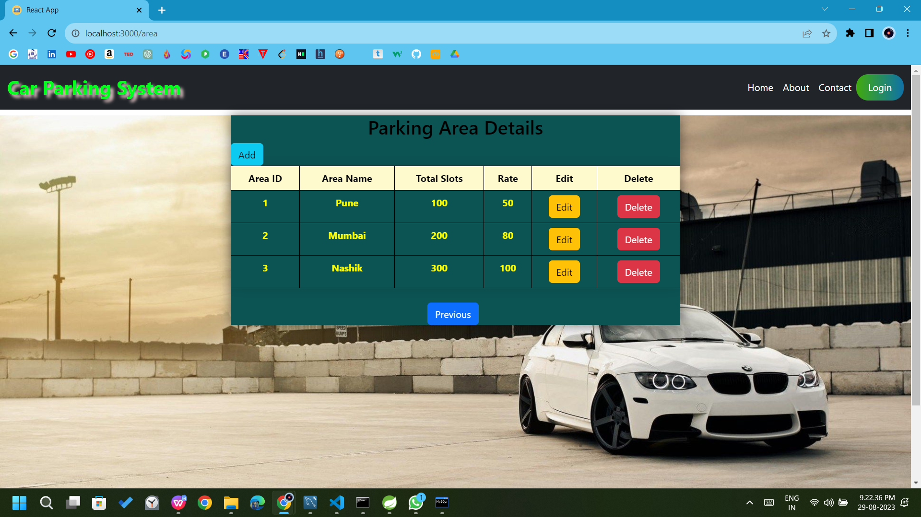
Admin dashboard

Slide 18
specifications
The application will use JavaScript, jQuery and CSS as main web technologies.
HTTP protocols are used as communication protocols. Client can access it via HTTP protocol.
Several types of validations make this web application a secured one.
Since EasyParking is a web-based application, internet connection must be established.
The EasyParking will be used on PCs and will function via internet or intranet in any web browser.

Slide 19
Software and hardware requirement
1 Hardware
The system requires the following hardware:
•RAM: 1 GB (further increase that as per requirement.)
•Hard Disk: 80 GB (further increase that as per requirement.)
•Display: 1024 * 768, True Type Color-32 Bit
•Mouse: Any Normal Mouse.
•Keyboard: Any window Supported Keyboard.
2 Software
•Database Server : MySQL Server
•Web Server : Internet Information Server
•Technologies : React js, CSS, SPRING BOOT

Slide 20
Future scope
This platform can be enhanced further by integrating payment gateway for customers In order to pay rent online
Customers forget password validated will be add and make as api more secure.
In future we would now like to improve financial transaction in computerized method according to time.
We will be thankful for your honest review of this software so we can make it even more efficient and update with new feature.

Slide 21
conclusion
Our System Online Car Parking Management System is mainly used in big cities where now finding parking space can cause a lot of traffic problems to other vehicle and can take much time. So, this version of computerized program will now help in those fields.
It can only be managed by one people efficiently. Although we have achieved many of our thoughts for this project but there are still some which we need to work.

Slide 22

references
https://bootstrapmade.com/mentor-free-education-bootstrap-theme/
https://www.javatpoint.com/java-mail-api-tutorial
https://www.w3schools.com/
https://javaee.github.io/javaee-spec/javadocs/
https://reactjs.org/docs/
https://docs.oracle.com/javaee/7/api/toc.htm

Slide 23
Thank you

